Slide 1

Big Data Analysis on Music Preference
Big Data Project Suggestion
Sep 28, 2017

Slide 2
Possible Problems to solve
Which music do the new listeners like?
Global Tendency by Demographics
Which genre/feature is currently gaining the preference?
Global Tendency by Genres(카테고리 변수)
What types of listeners are there?
Clustering User’s information(gender,
Which property of the music draws the type of listeners?
Measuring Correlations
Svm(support vector machine) 카테고리를 어떻게 숫자로?

Slide 3
Underlying Hypotheses
Preference is affected by culture.
Provides nation-level analysis boundary
Components of music would affect the music preference.
Different user groups by behavior would be more dependent on different fingerprint sets of the music.
Hypotheses will change or be added, as we analyze.

Slide 4
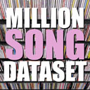




Available Data Source (Fingerprint)
Opensource solution
Manual Calculation
Music Fingerprints
(1M precalculated fingerprints by Colombia Univ.)
Basic Fingerprints
Loudness, Pitch, Tempo, Signature, Timbre, Length, …
Aggregated Fingerprints (Not Provided)
Chord Progress, Key Change, …
Metadata
Title, Year, Artist, Album, …
http://the.echonest.com/solutions/
https://labrosa.ee.columbia.edu/millionsong/

Slide 5
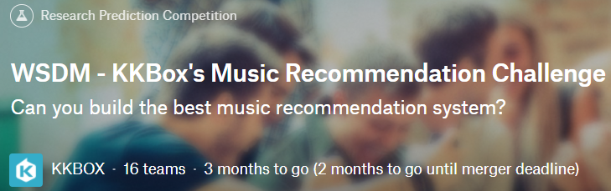

Available Data Source (Preference)
General Preference
Youtube Video Views
Sentiment-analyzed Social Media posts mentioning the song
Individual Behavior
Information and behaviors of KKBOX service users
(Given if we participate in the competition)
https://www.kaggle.com/c/kkbox-music-recommendation-challenge

Slide 6
Plans
Obtain the data
Measure the factors related to the problem
Write Python or R code to cluster and correlate the data
Build up the different models describing the user groups
Find the best model by test scores
Visualize the analysis result
Participate in the competition and submit our solutions
(If possible)

Slide 7
Appendix

Slide 8
Competition
Decide whether certain users would listen to the certain song repetitively
KKBOX is a Taiwan music service company, which means that the boundary of analysis would be Taiwan.
As data are provided in the raw form, the granularity of user demographics and song features are good. However, raw data means we need more time to process them.

Slide 9
Visualization
User groups by behavior, with favorite genres or songs
User groups by demographics, with favorite genres or songs
Genre map of the songs, with their popularity in color
Popularity graph of genres by time
and so on…

Slide 10
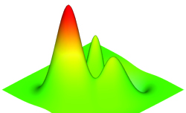
Landscape of the popular songs
Pop Music
Other Genres
Popularity
Fingerprint
Space

